Slide 1
Flight Departures during Taxiway C Construction
San Diego International Airport

Slide 2
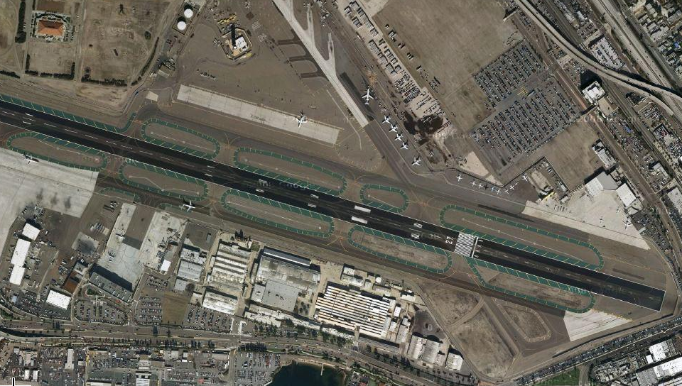
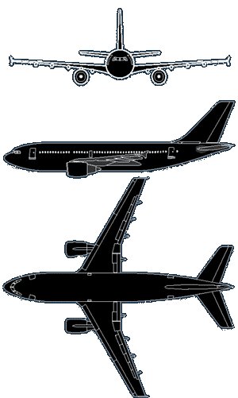
Phase 1
Start October 28,2009 = 78 Days of Construction

Slide 3
Phase 2
Start January 7,2010 = 66 Days of Construction

Slide 4
Phase 3
Start Feb 22, 2010 = 78 Days of Construction

Slide 5

Questions and Answers

